Slide 1
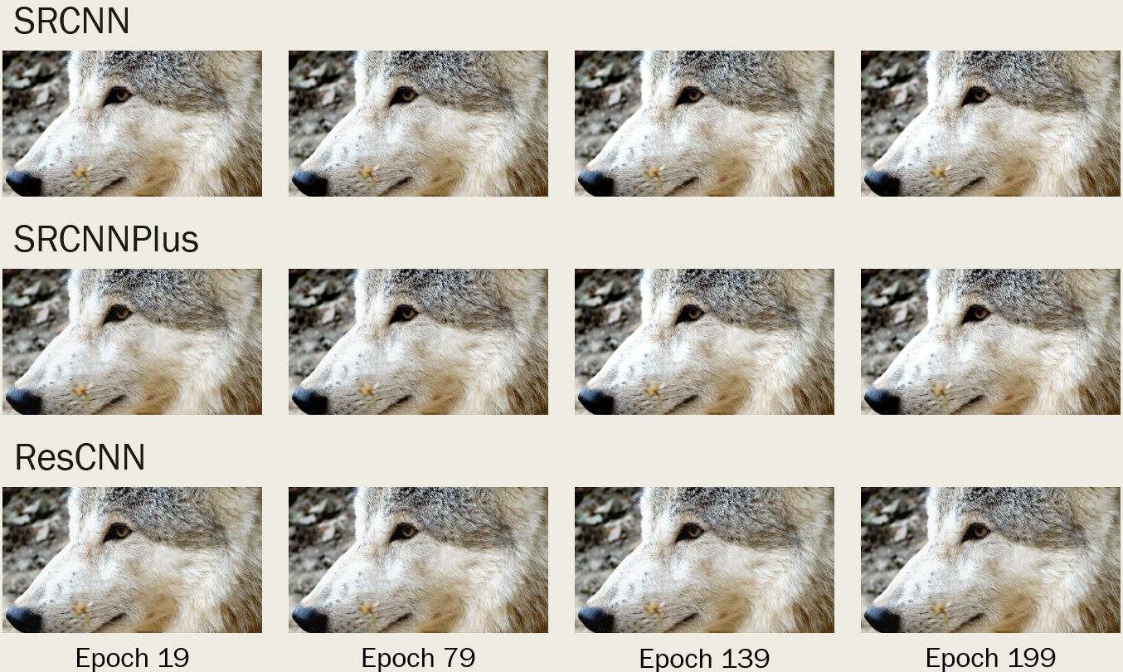
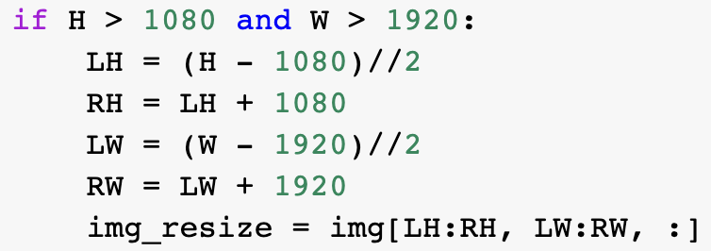
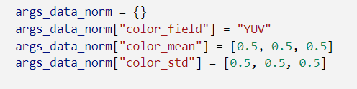
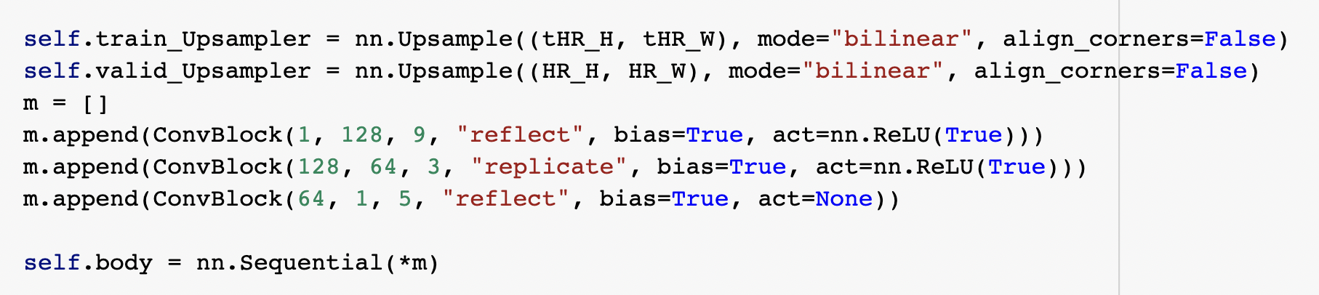
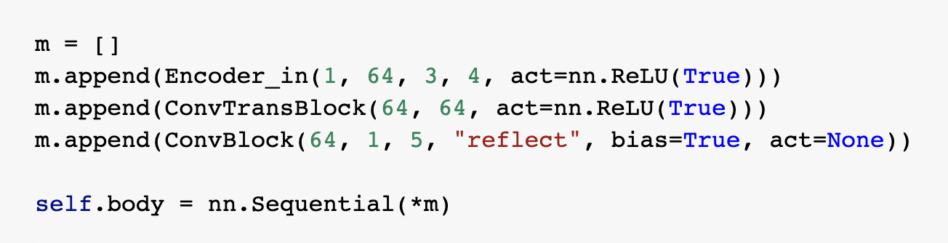
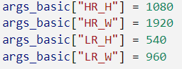
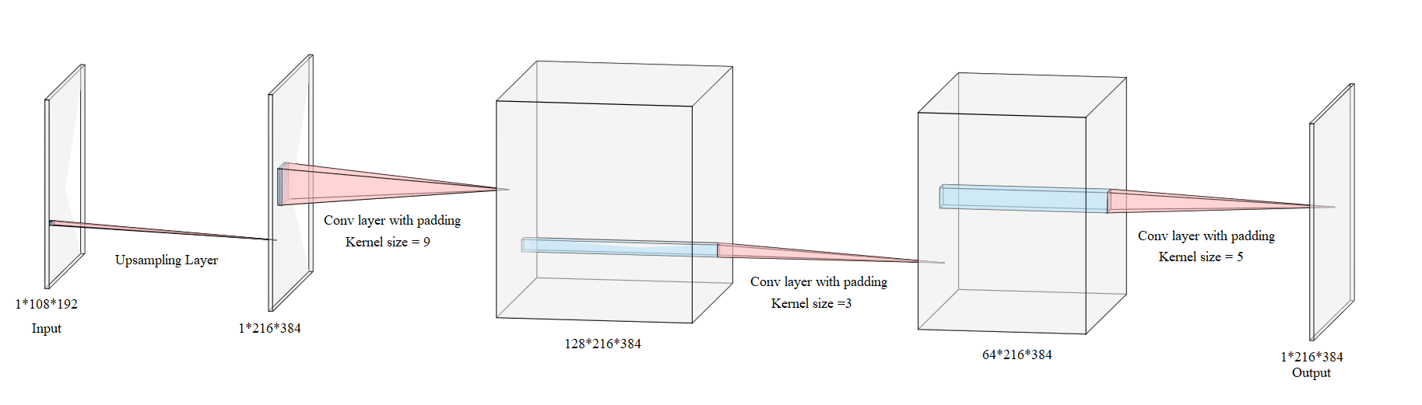
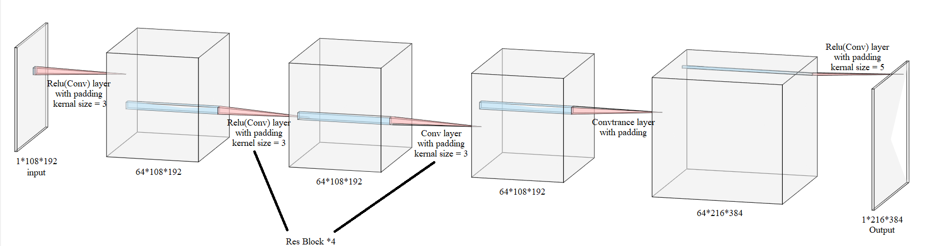
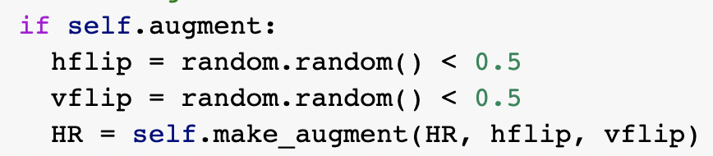
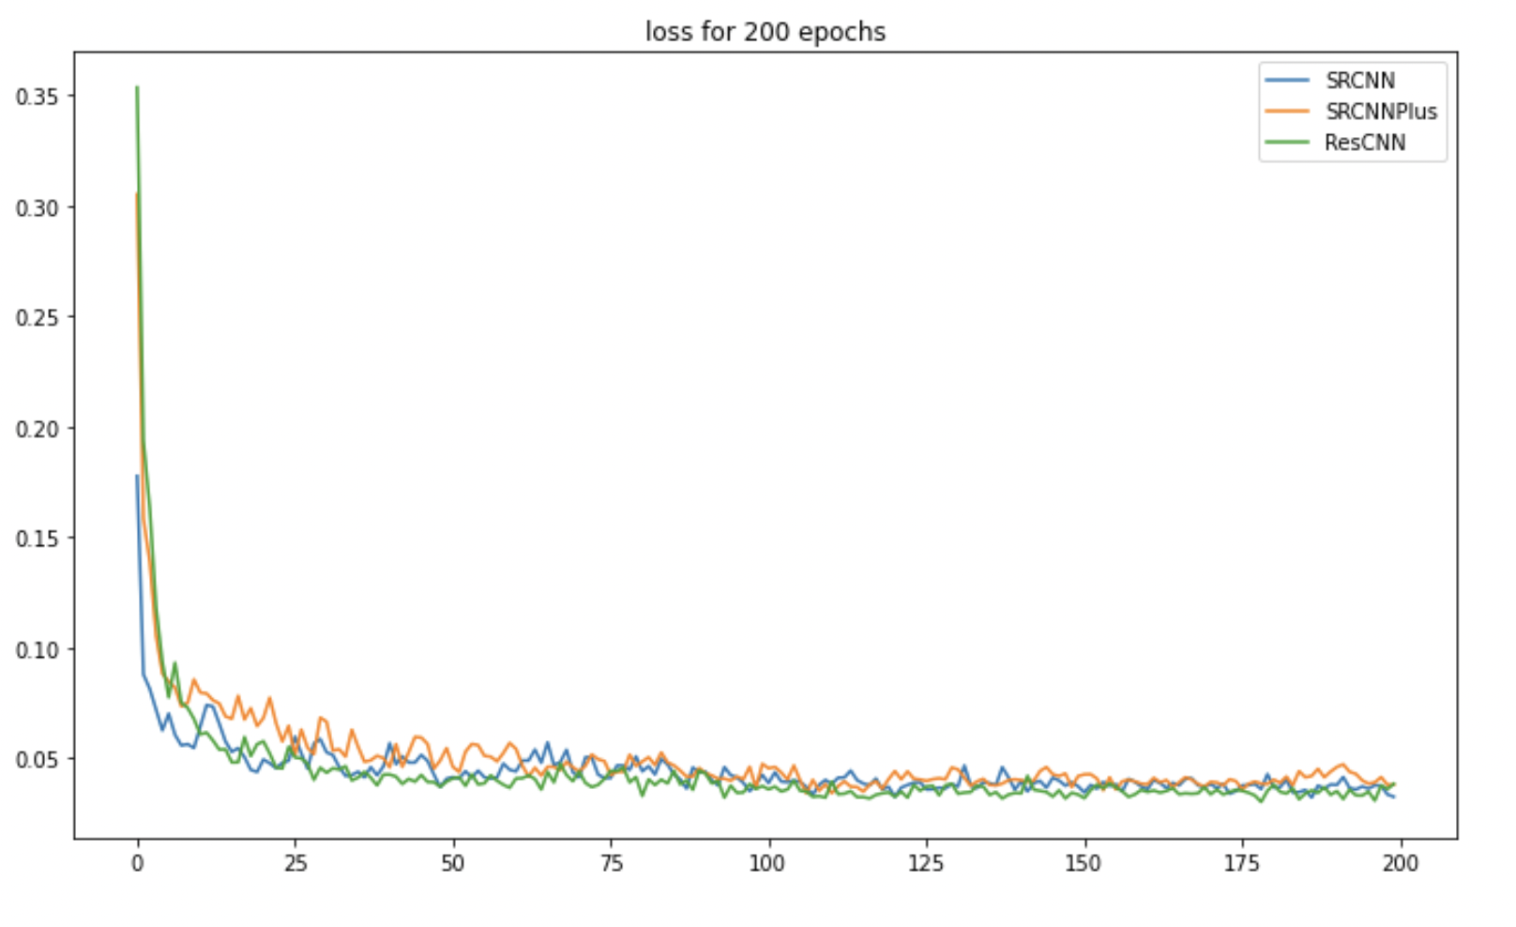
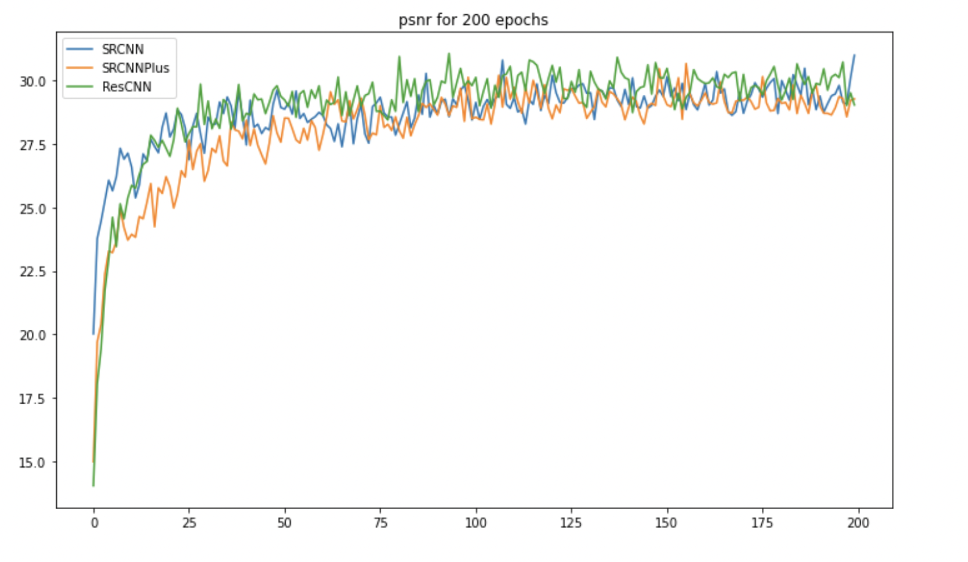
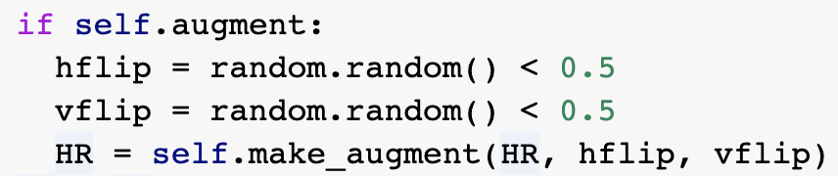
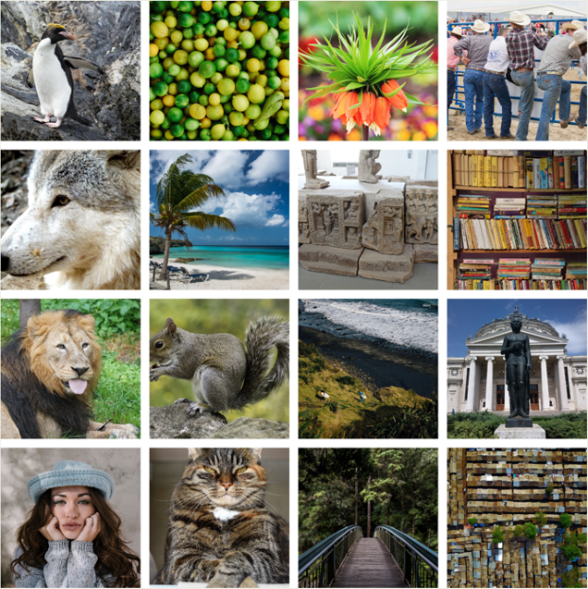
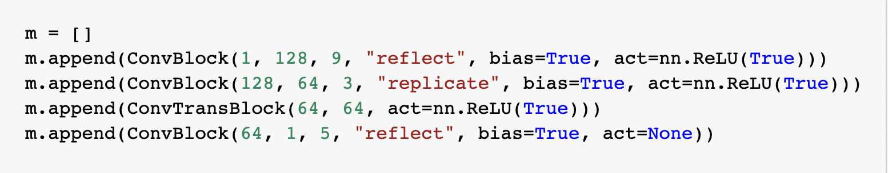
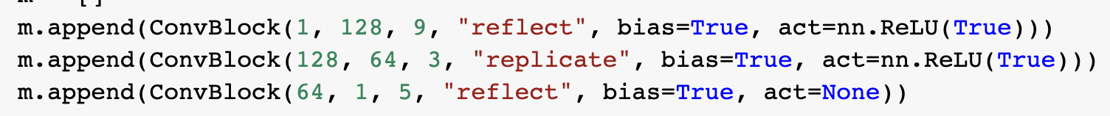
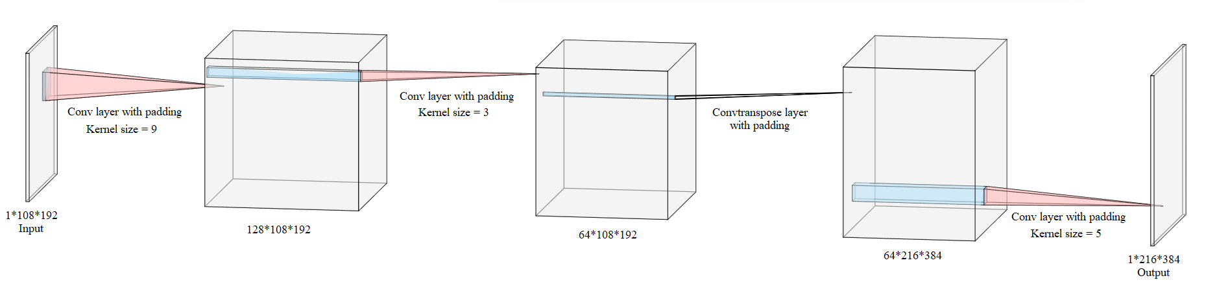
Image Super Resolution using SRCNN
Vikki Sui and Chengyi Yang
George Washington University
Introduction
Data pre-Processing
Model 1:SRCNN
Model 3:ResCNN
Image display
As the technology improving in recent year, our phone, iPad, laptop can display higher and higher resolution of image, but for some image we may not have the high-resolution version for some reason. So, Therefore, humans need some way to convert low resolution pictures to high resolution. With the advancement of computers and theory, the convolutional neural network (CNN) model of deep learning can be used to do exactly that.
In 2014, a network named Super-Resolution CNN(SRCNN) was published in the paper, "Image Super-Resolution Using Deep Convolutional Networks" by Chao Dong, et al. This model can improve the resolution of the picture very well.
In this project, we first rewrite the SRCNN model using pytorch and recorded the change in the peak signal to noise ratio (PSNR) of the image as the number of epochs increased.
Next, we changed the up-sampling layer in the SRCNN model to a convtrans layer to build an upgrade version of SRCNN model. We called it as SRCNNPlus. And recorded PSNR. The results obtained are almost the same as the original model.
Finally, we used Res Block to build a more complex model. We call it ResCNN. Through training and testing, the results obtained by this model are the best.
At the same time, we have added some new features in data loader. Allows the model to change the input color standard, between RGB and YUV. At the same time, it can enlarge pictures of any resolution to any desired multiple.
The dataset is from Kaggle: https://www.kaggle.com/datasets/bansalyash/div2k-valid-hr
It contains 400 train, 100 validation, but we only used 100 train and 20 validation.
Here are some images from the dataset:
1.Resize picture of various resolution into 1080*1920.
2.Read image in “YUV” instead of “RGB”.
3.Resize the picture with dimension 1080*1920(High resolution) into dimension 540*960 (Low Resolution).
The SRCNN model in the original paper is written by TensorFlow. Here, we rewrite it with pytorch.
This model has an up-sampling layer and 3 convolutions layers with padding. Their kernel sizes are 9, 3 and 5. For the two Conv layers, we use ReLu as the activation function, and the last Conv layer has no activation function.
The size of the input image is 1*108*192, and the output is 1*216*384.
Here are the coding and the structure of this model:
By using Res Block, we try to continue to improve the PSNR of upscaled images.
This model consists of a Conv layer with activation function, four Res Blocks, a Convtrans layer with activation function, and a Conv layer without activation function.
Among them, each Res Block consists of a Conv layer with activation function and a Conv layer without activation function. Activation function We still use ReLu function. The input size and out put size is the same as the former 2 models.
Here are the coding and the structure of this model:
The resolution of output image is 1080*1920
The Novelty of Our Projects
Our project can customize the size and magnification of the input image, which is very practical in practical use.
Our model is written in pytorch. Compared to TensorFlow in the original text, pytorch is now more widely used.
Our model can choose to use RGB or YUV as input color space for training. Only a few parameters need to be changed.
Data Loader
Lesson Learned for Our Group
1.Reference to the idea in pix2pix, in many cases, models trained by low resolution images perform better. So, we cut a small piece of image with a resolution of 108*192 from a 540*960 image and use it to generate an image with a resolution of 216*384.
2.Added the augmentation with 50% probability of doing a horizontal flip and 50% probability of doing vertical flip.
3.Because of the 2nd and 3rd channel of YUV is a linear combination of the 1st channel, we only used the 1st channel to train the model.
Although the CNN model was developed earlier among various deep learning models, it is also a relatively simple one. But the situations of its applications are still worth exploring.
The CNN model is not only able to handle the situation of image to label, but it can also handle image to image as well.
Sometimes a simple model can get a quite good result. But if you want to improve further on this result, it may take a lot of time to readjust.
When working on a project, it’s not just special needs to be considered. Sometimes a little more work can make a project suitable for a variety of situations.
Model Result & Conclusion
Model 2: SRCNNPlus
Trained each model for 200 epochs, save the images generate by training every 20 epoch. We set the beginning learning rate is 0.001 and will decrease 50% when the epoch reaches 100.
The result of model training can be shown in the following two plots:
In order to improve the output PSNR, we improved the model and built the SRCNNPlus model. The input size and out put size is the same as the original model.
This model has a convtrans layer and 3 convolutions layers with padding. Their kernel sizes are 9, 3 and 5. The first three layers with ReLu function as activation function and the last layer without.
Here are the coding and the structure of this model:
Information about Dataset
Acknowledgement
We are greatly appreciating Prof. Fang Jin. Through her course, we learned a lot about deep learning. At the same time, we would also like to thank the TA (Zhou Yang) of this class, he is a very competent and kind TA, who answered a lot of questions to the students during the Office Hour.
The two plots show that:
All of three model convergence very fast. When the number of epochs is close to 30, all three models are nearly convergent.
Among these models, ResCNN performs best. The final PSNR can be larger than 30dB. This means that there is no visible difference between the increased resolution image and the original image.
So, we can make a conclusion that the ResCNN model can be used to improve the resolution of images.
References
http://mmlab.ie.cuhk.edu.hk/projects/SRCNN.html
https://github.com/kunal-visoulia/Image-Restoration-using-SRCNN#:~:text=The%20SRCNN%20is%20a%20deep,quality%20of%20low%20resolution%20images
GitHub Link
https://github.com/VikkiSui1129/6289HW/tree/main/final_proj

